Slide 1



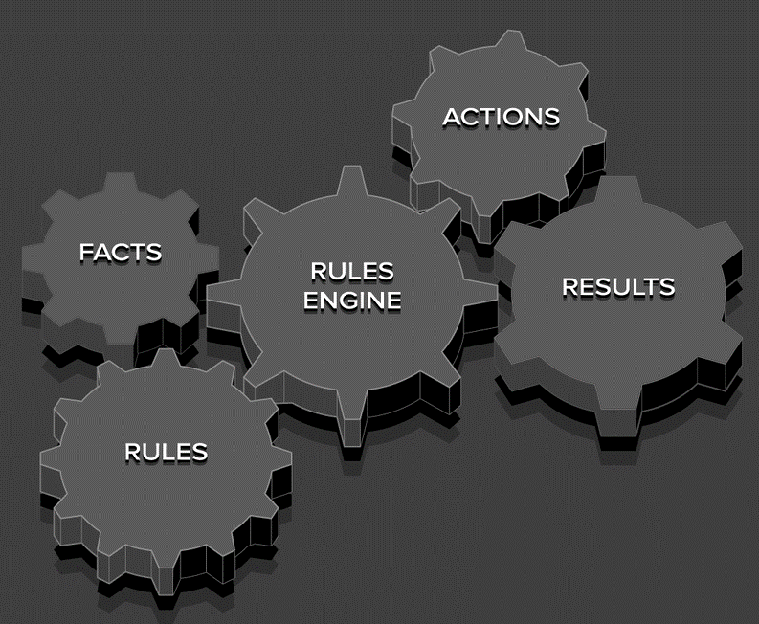





Signals an event
Event is converted into LLM command and enriched with data and available actions
Knowledge
Actions / Functions
{
"Damage": {
"Bodywork": {
"Front": "66.4 %",
"Left": "0.0 %",
"Rear": "0.0 %",
"Right": "33.6 %"
},
…
}
}
plan_pitstop
cancel_pitstop
report_damage
report_low_fuel
…
LLM calls one or more of the available functions to handle the event and the current situation in the knowledge base
Create facts and call rules, thereby starting another cycle
Call functions and methods in Simulator Controller
Function executes and can…
Generate voice output

